Slide 1
Saxo Service Blueprint: Bridging Old and New World with Kubernetes Operators
Jinhong Brejnholt
Saxo Bank

Slide 2








App code
Infra config
APP
jbrejnholt

Slide 3

jbrejnholt

Slide 4


App code
Infra config
APP
jbrejnholt
Notes:
Suddenly, something breaks. Your application starts failing without any changes made to your app nor infra git repo.
You wonder.. I didn't change anything

Slide 5
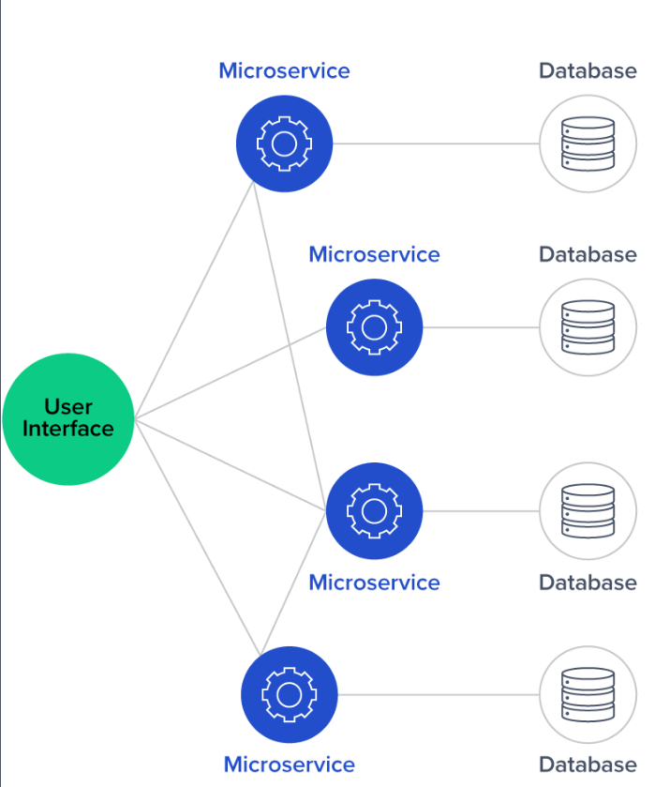
UI
APP
jbrejnholt
Notes:
You dive deeper, it turns out your app is no longer having the access to a dependent app.
You contact the respective teams, it turns out a routine cleanup script removes the permission that your app depends on, which caused your healthy pod can't talk to others anymore.

Slide 6

jbrejnholt
Notes:
Your confidence in GitOps starts to fade. Because what GitOps promises – predictable infrastructure through declarative code – doesn't apply to all the external dependencies your service relies on.

Slide 7

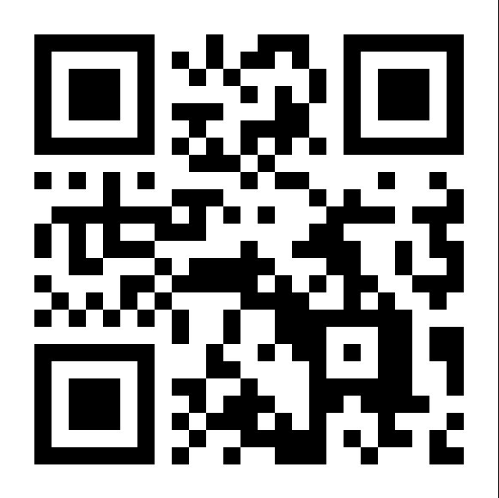
What percentage of your company’s applications are running in Kubernetes today
jbrejnholt
Notes:
Vote: https://directpoll.com/v?XDVhEthucAPpiumG9lWmFNDGyVUI8NlQqP5ZuZm
Result: https://directpoll.com/r?XDbzPBd3ixYqg89RHpyIsHwL6iZvhcfndA3lIkvVnM8e8ZFtZ

Slide 8

~30%
100+ namespaces
60+ teams
1000+ applications
Notes:
For us - also long way ahead

Slide 9






UI
APP
jbrejnholt
Notes:
There are even more dependencies than just other applications and databases
Kafka, IDP, secret server, firewall, certs, dns,

Slide 10

jbrejnholt
Notes:
More developers want own a land and start farming now
At Saxo - if you claim something is difficult/impossible

Slide 11

jbrejnholt
Notes:
Somebody is gonna be.. Hold my beer

Slide 12


About Us
Online trading and investment
$17 billion daily trade
200+ banks and brokers
1.4 million clients
€118 billion in client assets
jbrejnholt
Notes:
Saxo Bank is a Danish investment bank specializing in online trading and investment. It was founded as a brokerage firm in 1992, under the name Midas Fondsmæglerselskab, by Lars Seier Christensen, Kim Fournais, and Marc Hauschildt. The name was changed to Saxo when the company obtained a banking license in 2001.
Saxo Bank A/S is a fully licensed and regulated Danish bank with an online trading platform that empowers you to invest across global financial markets.

Slide 13


jbrejnholt
Notes:
2018 we embarked a cloud jounery

Slide 14

Cloud to Cloud Native
Multi-Cloud
Hybrid Cloud
Cloud Native
DR & Cost
Cloud-First
jbrejnholt

Slide 15




jbrejnholt

Slide 16
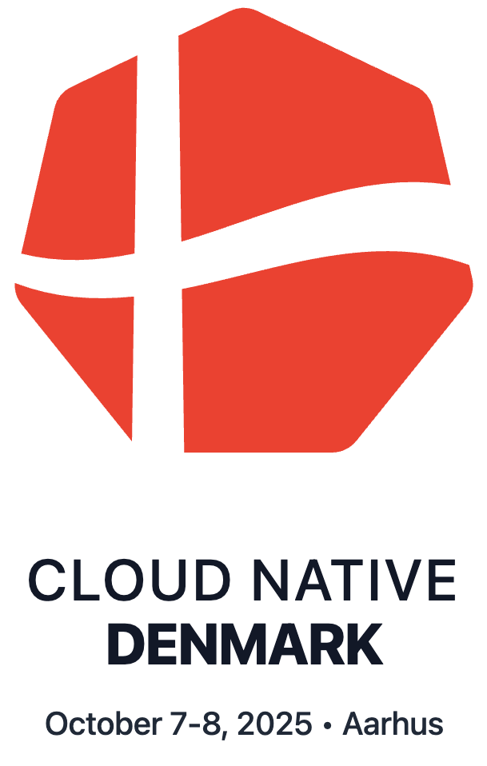

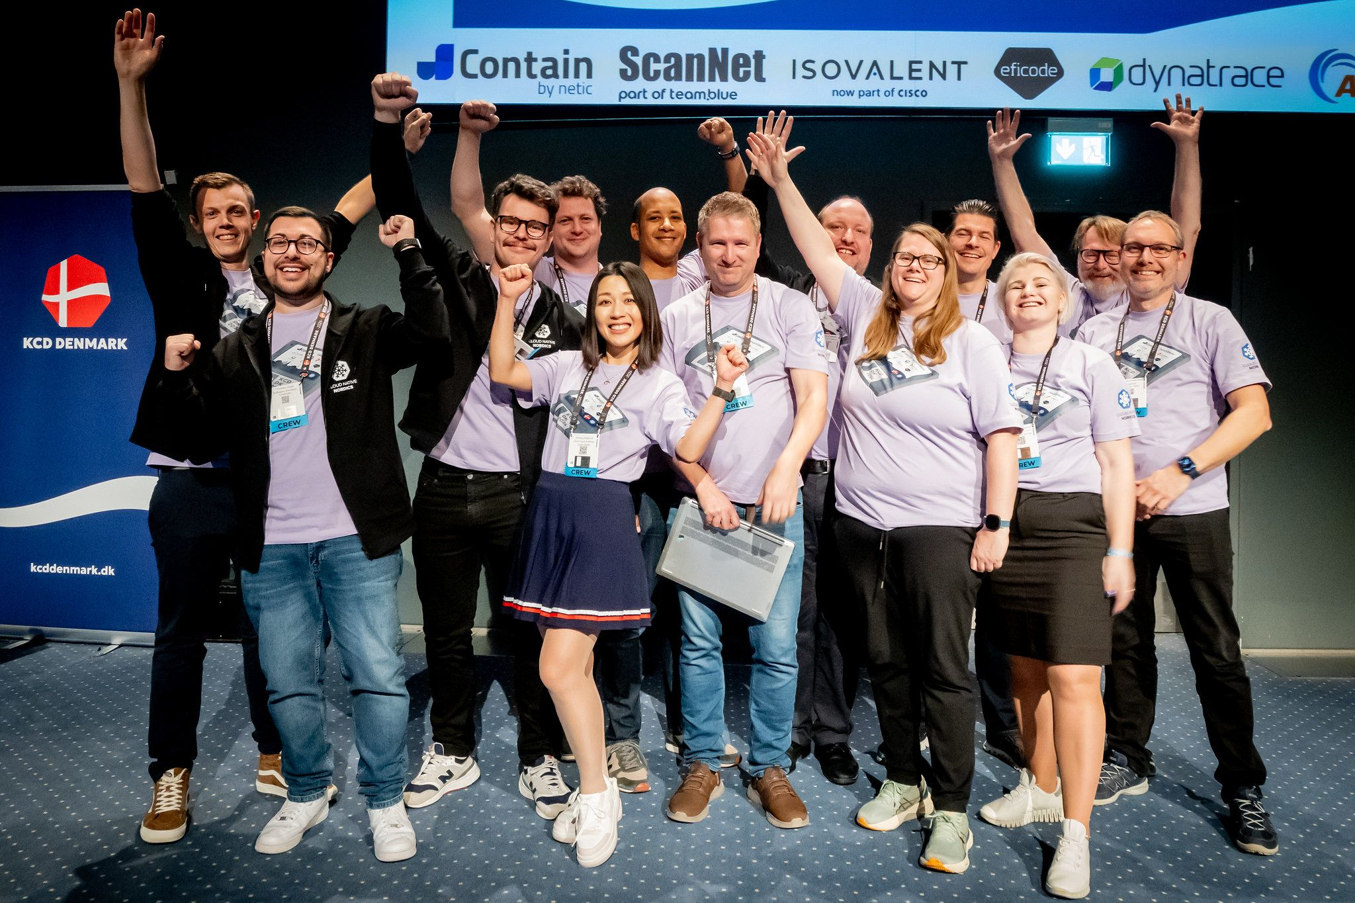

Cloud Native Community
jbrejnholt
Notes:
Encourage Saxonians to learn
Contribute to the community - org
Sharing what we learn

Slide 17
UI
APP
jbrejnholt
Notes:
Let's go back to the mess, so how do we approach it

Slide 18


jbrejnholt
Notes:
All the tool box we need
Declaritive
Yaml

Slide 19
Saxo Service Blueprint Story
📖 The Adventure of the Four Friends Who Built the Bank’s Blueprint
Once upon a time, in the bustling city of Saxo Bank, there lived four very busy friends. Together, they kept the land of Services running smoothly.
jbrejnholt

Slide 20
📚 Service Catalog – The Librarian
He had a magical library where every service in the kingdom kept its own special book.
Each book told the story of what the service does, where it lives, who takes care of it, and what it needs to talk to.
Service Catalog was the only place where these stories could be written down — the heart of the kingdom’s knowledge.
jbrejnholt

Slide 21
🧭 DevReach – The Explorer
He was an explorer and a guide.
If anyone in the kingdom wanted to find something — a service’s owner, its secrets, its friends (like Kafka topics) — DevReach could show them the way.
He could even tell you how the services were feeling and whether they were working well.
In short, DevReach was the kingdom’s “ask me anything” friend.
jbrejnholt

Slide 22
📜 Service Blueprint – The Teacher
She was the storyteller.
Her scrolls explained how to use the kingdom’s magic:
“How to get a Kubernetes namespace,”
“How to borrow a key to another service’s castle,”
“How to summon a managed identity dragon.”
She also shared tales of the past and dreams of the future — where the kingdom’s automation magic was heading next.
jbrejnholt
Notes:
Documentation site How to guide

Slide 23
🛠️ Infrastructure Automation – The Builder
He was the builder and fixer, always on the move.
If Service Catalog said a service needed a castle, a bridge, or a magic key, Infrastructure Automation made it happen — quickly and correctly.
He commanded a team of Operators who flew across all the Kubernetes lands, making sure everything was just right.
jbrejnholt
Notes:
The operators

Slide 24
Saxo Service Blueprint Story
🧩 Blueprint
Together, these four friends formed The Blueprint — a map of how services were created, cared for, and connected in Saxo Bank.
Service Catalog wrote the truth. DevReach spread the truth. Service Blueprint taught the truth. Infrastructure Automation made the truth real.
And so, the kingdom ran smoothly — as long as everyone remembered to visit all four friends when they needed help.
The end.
jbrejnholt
Notes:
Now let's see how it works in the real world

Slide 25






Saxo Service Blueprint
APP
jbrejnholt

Slide 26
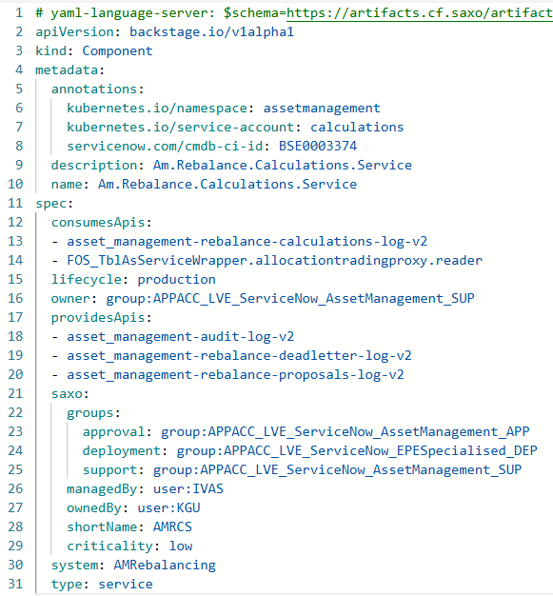
jbrejnholt
Notes:
I'm tired of adding more animation - deal with pointer

Slide 27
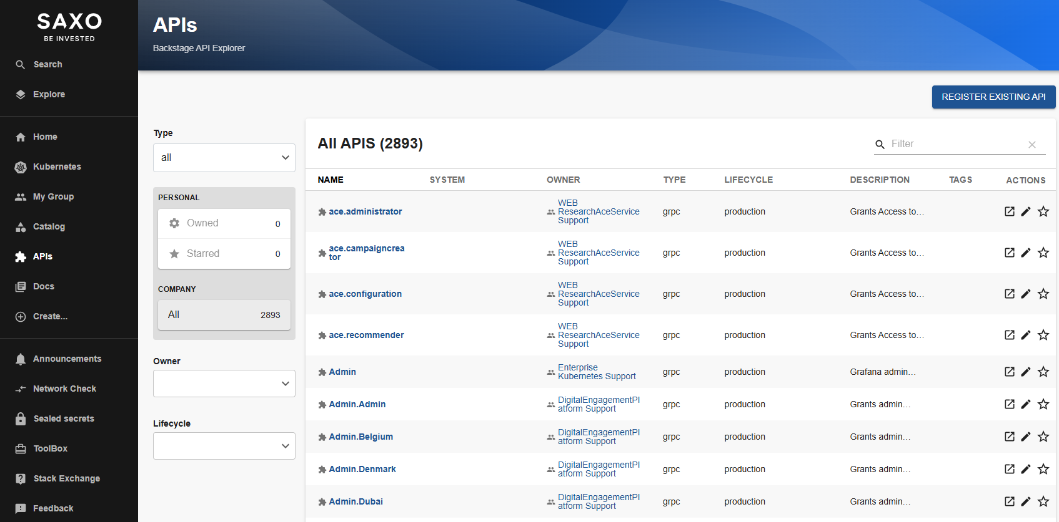
jbrejnholt

Slide 28
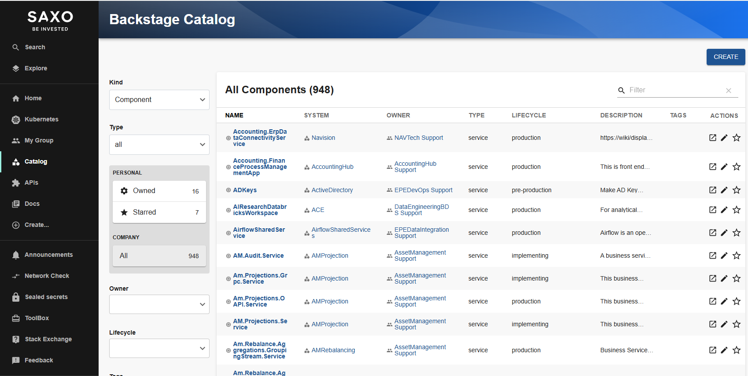
jbrejnholt

Slide 29
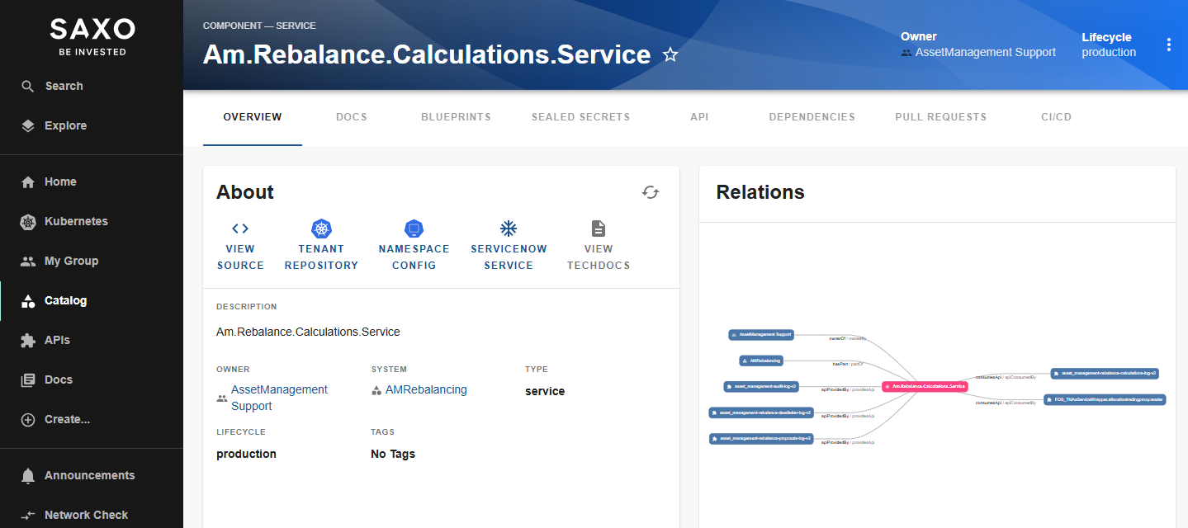
jbrejnholt

Slide 30
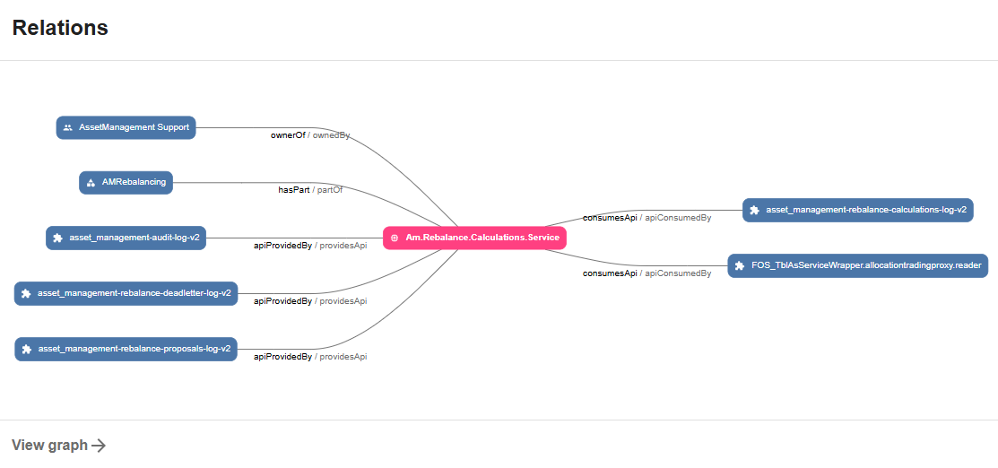
jbrejnholt

Slide 31
Notes:
While we at Backstage – it’s an excellent product – many great plugins. Good example

Slide 32
jbrejnholt

Slide 33
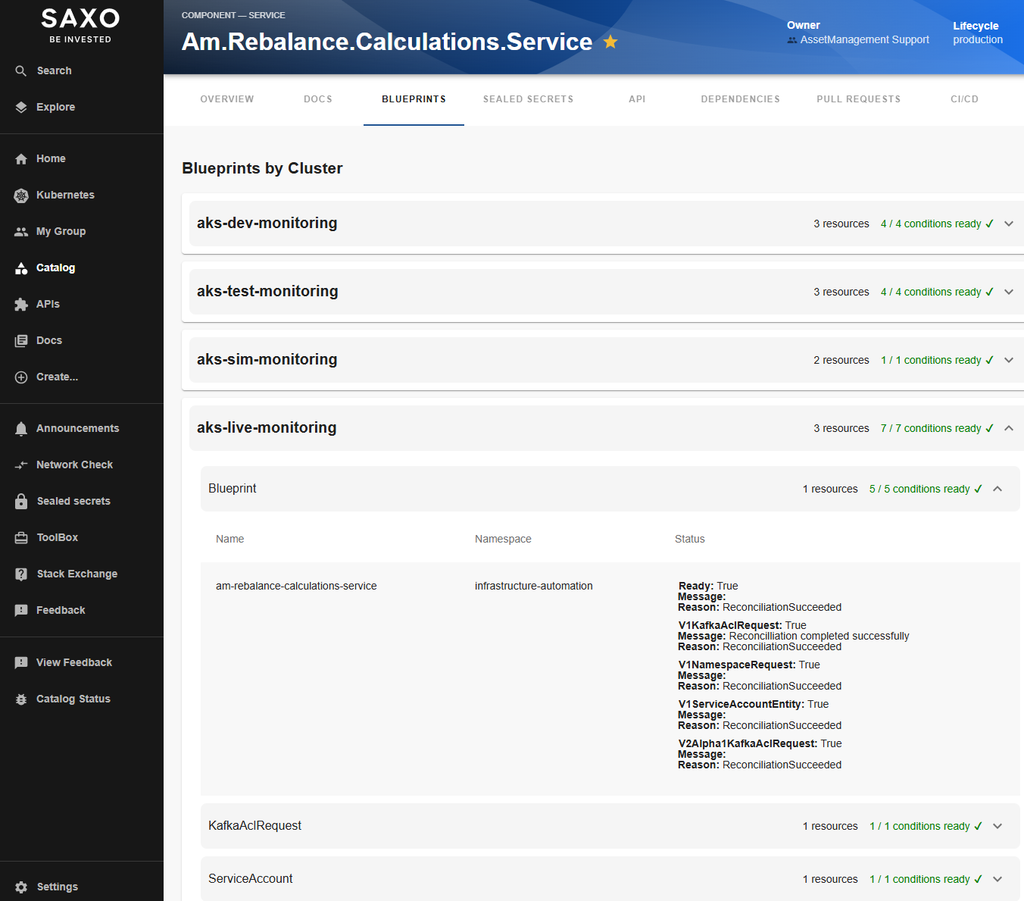
jbrejnholt

Slide 34
Role | benefit
Developer | Clarity of Requirements
Platform Teams | Automation of Provisioning
Security/Governance | Traceability & Control
jbrejnholt
Notes:
Developer Clarity of Requirements
Platform Teams Automation of Provisioning
Security/Governance Traceability & Control

Slide 35
UI
APP
jbrejnholt
Notes:
before Blueprint - don't know where is the issue and who to contact

Slide 36
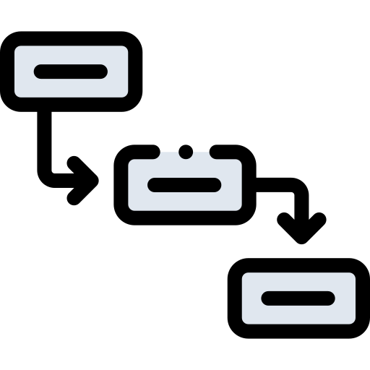
App code
Infra config
APP
Blueprints
jbrejnholt
Notes:
This is where we are heading
Dependencies are also maintained

Slide 37

How is the adoption?
jbrejnholt

Slide 38

Statistics for 2025​ H1
Service Catalog​
701 PRs completed
Access requests from 109 distinct developers​
Live environment example Blueprints
534 Kafka topic read/write access ​
38 database roles​
88 EntraID roles​
…

Slide 39

BEFORE BLUEPRINT
AFTER BLUEPRINT
jbrejnholt
Notes:
We are trying very hard to keep our developers happy with Blueprint

Slide 40


Learnings
GitOps ≠ App Readiness
Declared → Automate
Service-to-service trust: First-Class
Automation is a journey
Platform Developer
jbrejnholt
Notes:
GitOps ≠ App readiness
You can’t automate what you haven’t declared
Service-to-service trust needs to be first-class
Automation is a journey (release, feedback, improve)
Platform and developer collaboration is key
We learned these lessons the hard way. GitOps gets you part of the way, but not all the way. Especially in a regulated industry like fintech, you need stronger guarantees and systemic thinking.”

Slide 41

Don’t just GitOps your infrastructure – Blueprint your intent
jbrejnholt
Notes:
So if your GitOps setup still surprises you at runtime, maybe it’s time to take a step back and blueprint what your application truly needs.
Don't just GitOps your infrastructure - Blueprint your intent.

Slide 42


Questions
jbrejnholt

